Slide 1

July 2020
NBA - Score Prediction
Predict from dataset with all NBA games from 2004 Season to Feb. 2020
India Lindsay, Zeba Pathan, Suchit Das, Sujay Chebbi, Adam Hoard, Yiming Jin
MSBA, The University of Texas at Austin

Slide 2
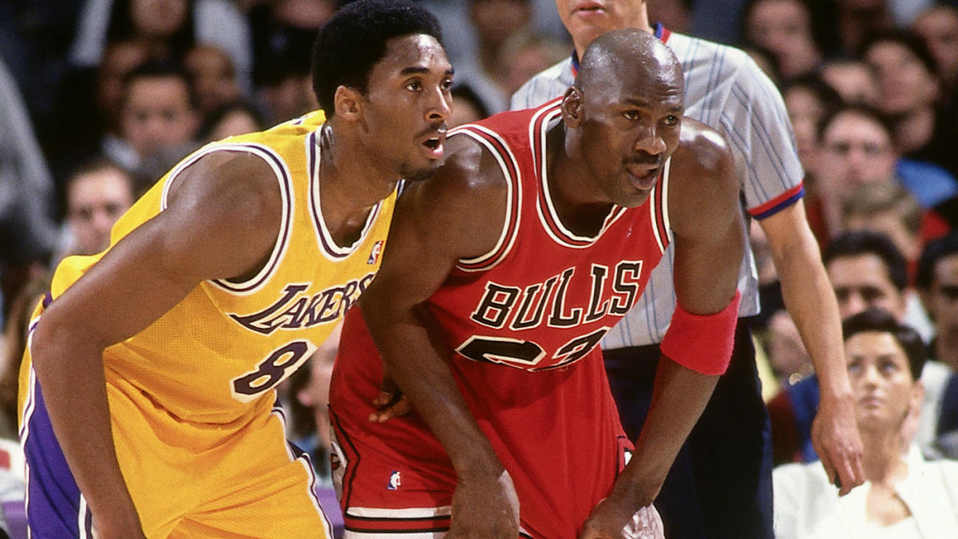
Project Introduction
Basketball
a game between two teams who score by tossing an inflated ball through a raised goal. The winner of the game scores more points.
Our Task
Predict how many points a team will score based on other offensive metrics:
Assists
Rebounds
Field Goal Percentage
3PT Percentage
Free Throw Percentage
Notes:
#training/test/validation sets
#run our two approaches on the training data (dfTraining)
#validate each approach using kfold cv on the validation set (dfValidation)
#the last group will run the best approach on test data (dfTest)

Slide 3
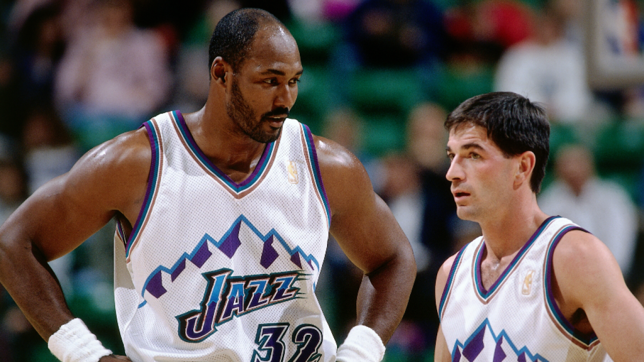
Model Selection Process
Split data into three groups:
Training (50%)
Validation (25%)
Test (25%)
Fit models using training set, obtain test RMSE using validation set and compare to select optimal model
Fit optimal model using train and validation sets combined
Obtain out of sample error for optimal model by predicting y values using test set

Slide 4
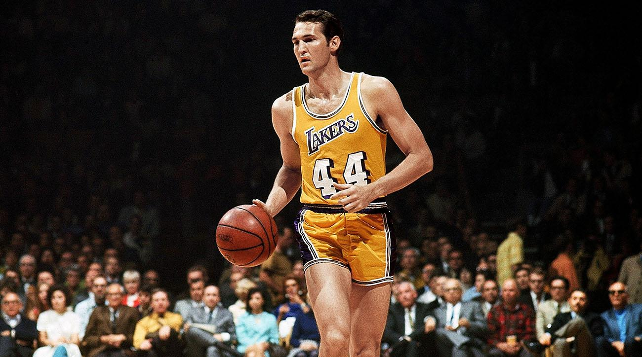
Univariate Analysis
Implementing a linear model with one variable at a time for Points (PTS_home)
Model | Predictor | Variable Name | Model RMSE
Linear Model | Field Goal Percentage | FG_PCT_home | 9.623471
Linear Model | Free Throw Percentage | FT_PCT_home | 12.77778
Linear Model | 3 point Percentage | FG3_PCT_home | 11.74781
Linear Model | Assists | AST_home | 10.4955
Linear Model | Rebounds | REB_home | 12.79566

Slide 5

Multivariate Model 1: Stepwise Regression
We try to get the response by implementing step regression model in 3 directions: Forwards, Backwards and Both
We start by adding each variable until we get a optimal mix or sequentially delete each until reach an optimal mix of variables
We calculate the error (RMSE) for each of the direction to find the best fit
Step Direction | Final Predictors | RMSE
Forwards | FG_PCT_home FT_PCT_home FG3_PCT_home AST_home REB_home | 8.025279
Backwards |  | 8.025279
Both |  | 8.025279
Notes:
#training/test/validation sets
#run our two approaches on the training data (dfTraining)
#validate each approach using kfold cv on the validation set (dfValidation)
#the last group will run the best approach on test data (dfTest)

Slide 6
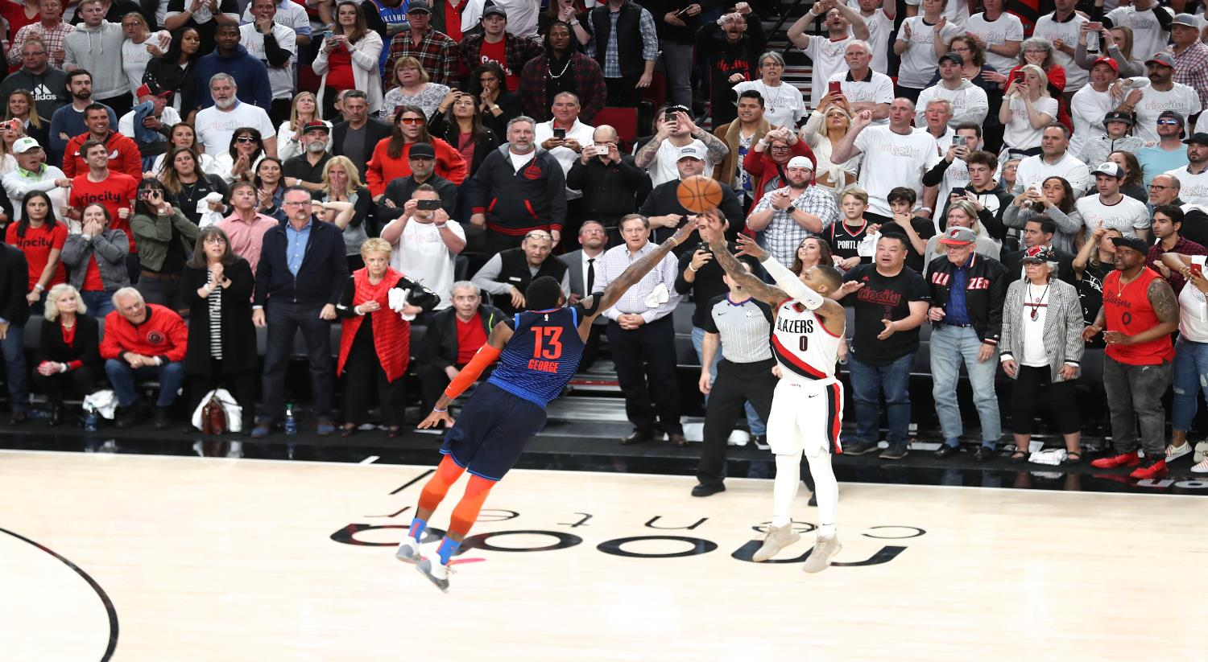
Model Selection
Model | Validation set RMSE
Univariate Regression (Field Goal %) | 9.623471 (Lowest RMSE)
Stepwise Regression (All 3 Directions) | 8.025279
Ridge Regression | 8.025234
Lasso Regression | 8.025041
PCR | 8.025279
PLS | 8.032477
Gradient Boosting Method (GBM) | 16.14957
Notes:
Predicting points pet game only using 5 variables. None of these models selected out any parameters, they were all included because they were all equally influential so the test error did not differ much

Slide 7

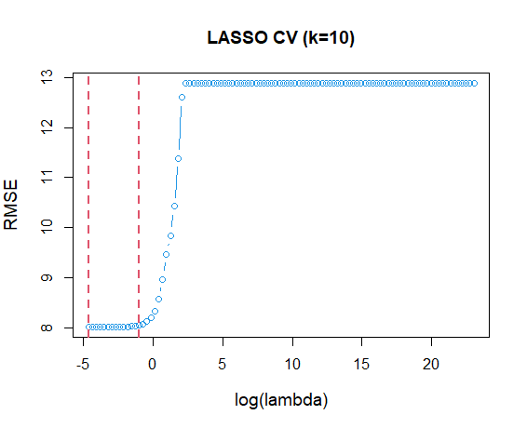
Lasso: Identifying Lambda
Min. Lambda: 0.01
Test Error: 7.831
Lambda 1 SE: 0.376
Test Error: 7.877
Notes:
#training/test/validation sets
#run our two approaches on the training data (dfTraining)
#validate each approach using kfold cv on the validation set (dfValidation)
#the last group will run the best approach on test data (dfTest)

Slide 8

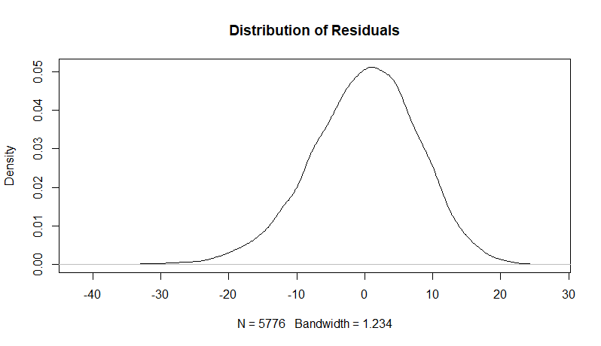
Lasso Residuals Plots
Notes:
#training/test/validation sets
#run our two approaches on the training data (dfTraining)
#validate each approach using kfold cv on the validation set (dfValidation)
#the last group will run the best approach on test data (dfTest)

Slide 9
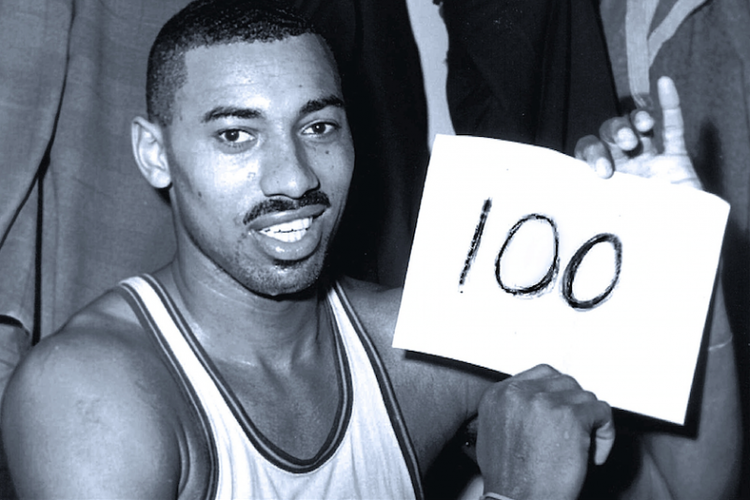
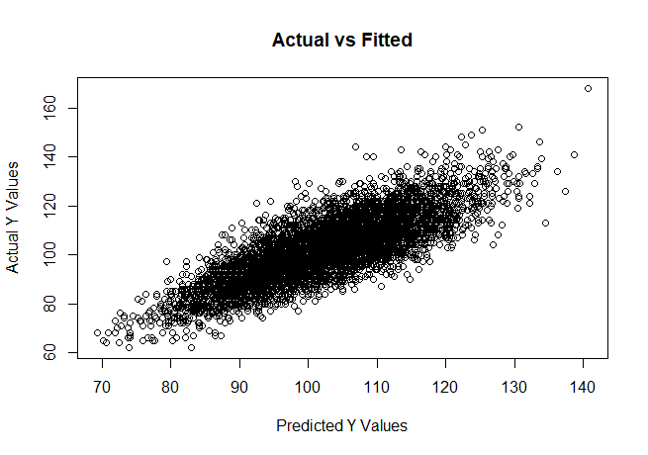
Optimal Multilinear Formula
Ŷ = -10.702 + 120.552(FG_PCT) + 22.557(FT_PCT) + 13.551(FG3_PCT)
+ 0.597(AST) + 0.5(REB)
Adjusted R-squared: 0.633
Notes:
#training/test/validation sets
#run our two approaches on the training data (dfTraining)
#validate each approach using kfold cv on the validation set (dfValidation)
#the last group will run the best approach on test data (dfTest)

Slide 10
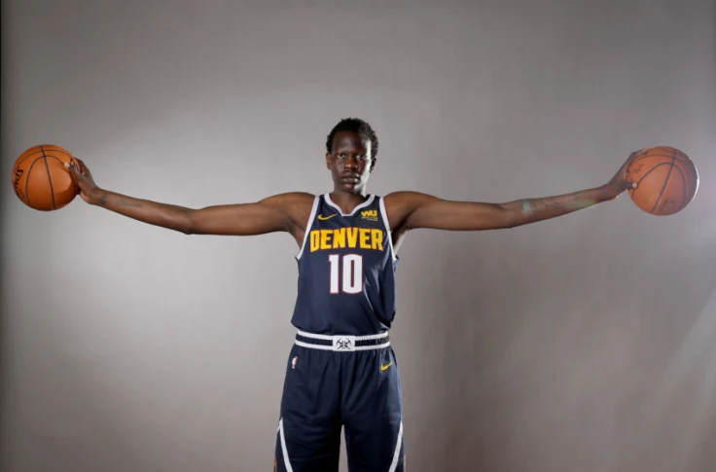
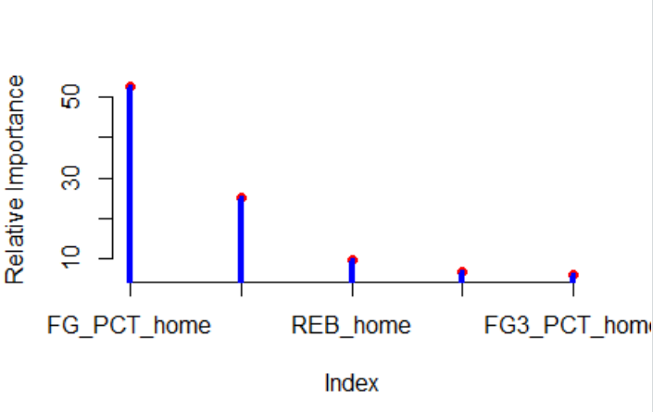
Boosting
Predictor | Relative Importance
FG_PCT_home | 52.62
AST_home | 25.12
REB_home | 9.45
FT_PCT_home | 6.75
FG3_PCT_home | 6.03

Slide 11

Interpreting the Results
Field Goal Percentage (FG_PCT) was determined to exert the most influence
Stats (from last season):
 | LAL | ORL | MIA | MIL
Field Goal Percentage | 46% | 44.2% | 47% | 44.7%
Free Throw Percentage | 58.3% | 77% | 77.8% | 72.3%
3 point Percentage | 37.5% | 34.1% | 38.3% | 37.2%
Assists | 24 | 24 | 26 | 27.8
Rebounds | 46 | 44.5 | 44.5 | 52.7
Predicted Score | 107 | 111 | 117 | 107
Actual Score | 114 | 106 | 112 | 118
Notes:
#training/test/validation sets
#run our two approaches on the training data (dfTraining)
#validate each approach using kfold cv on the validation set (dfValidation)
#the last group will run the best approach on test data (dfTest)

Slide 12
Interpreting the Results
Stats (from the games on July 25th):
 | LAL | ORL | MIA | MIL
Field Goal Percentage | 56.9% | 34.3% | 41.4% | 44.4%
Free Throw Percentage | 77.8% | 84.1% | 79.5% | 78.9%
3 point Percentage | 45% | 17.9% | 44.4% | 35%
Assists | 24 | 21 | 29 | 25
Rebounds | 49 | 45 | 54 | 47
Predicted Score | 120 | 87 | 107 | 103
Actual Score | 119 | 112 | 99 | 131
Notes:
#training/test/validation sets
#run our two approaches on the training data (dfTraining)
#validate each approach using kfold cv on the validation set (dfValidation)
#the last group will run the best approach on test data (dfTest)

Slide 13
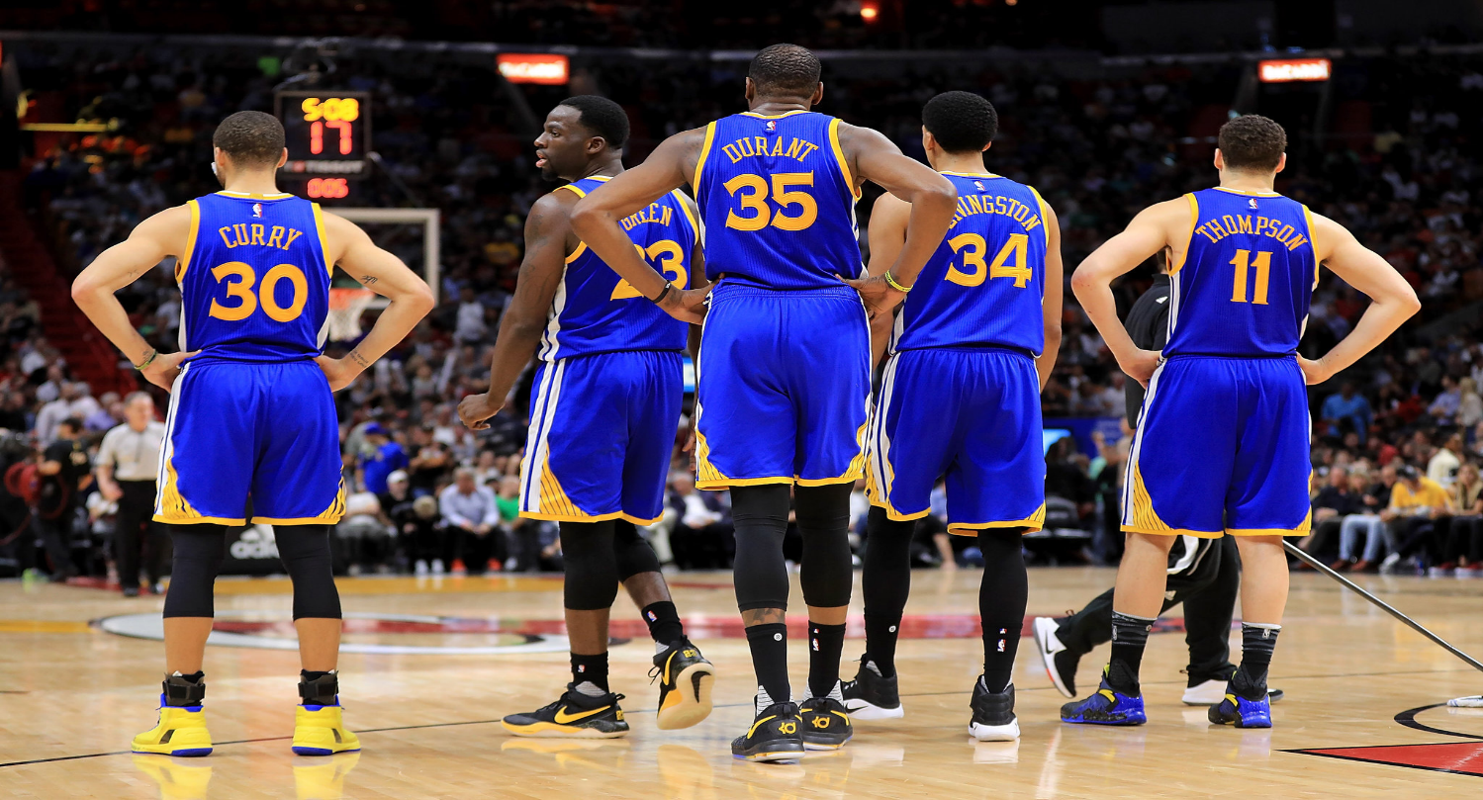
Data Set Shortcomings
Does not account for volume of shots taken
50% FG_PCT could be 3/6 or 20/40
Does not account for style of offense played
Assists directly correlate to points
Houston Rockets are near the bottom of the league in assists but one of the top in points per game
Notes:
#training/test/validation sets
#run our two approaches on the training data (dfTraining)
#validate each approach using kfold cv on the validation set (dfValidation)
#the last group will run the best approach on test data (dfTest)

Slide 14
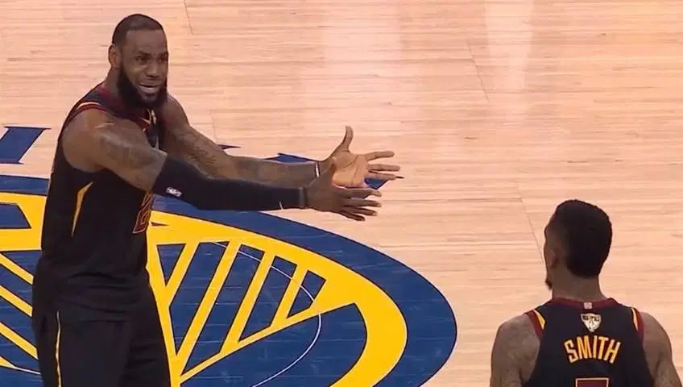
Questions?
Notes:
#training/test/validation sets
#run our two approaches on the training data (dfTraining)
#validate each approach using kfold cv on the validation set (dfValidation)
#the last group will run the best approach on test data (dfTest)

Slide 15
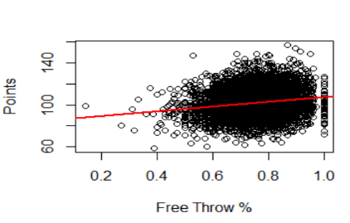
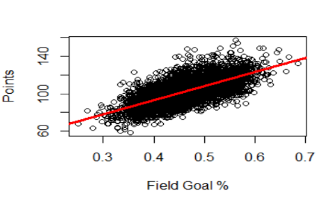
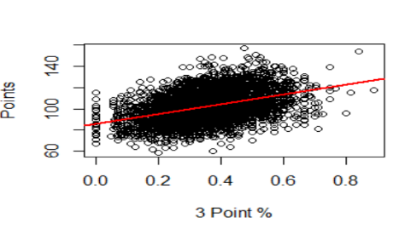
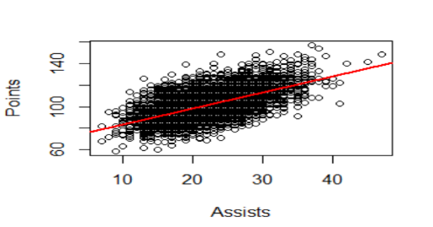
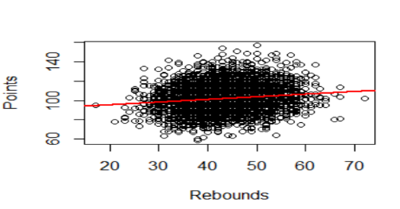
Appendix: Univariate Analysis Fits

